Slide 1

WELCOME
From the team of :
Anjali Krishna(20419018)
Aparna Unnikrishnan(20419024)
Ashana(20419026)

Slide 2
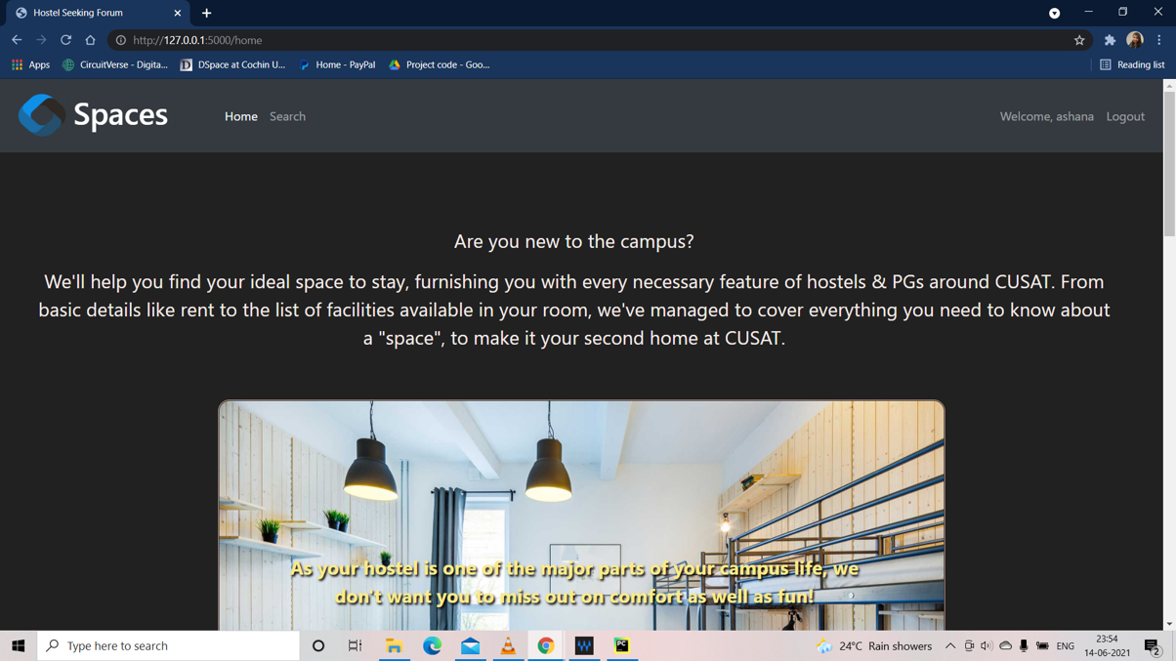

Hostel Seeking Forum
Spaces

Slide 3

Abstract
Input and Output
Tools and Languages used
ER Diagram
DFD for User
DFD for Admin
Architecture
Gantt Chart
Snapshots
Presentation Highlights

Slide 4

Abstract
Hostel Seeking Forum is an RDBMS project which is done as a finding tool for students . The main aim of this project is to help the new comers who join the college .Here, they are free to make an account and seek for their hostels .We also provide a platform for hostel owners to post their hostel details , like rent , location , availability of rooms ,curfew, and a small description about their particular hostel on the website . Students can look up information about the hostels near CUSAT and choose the right one . This will provide a quick access of hostels and save the time.
Step 1
2017
Step 2
2018
Step 3
2019

Slide 5
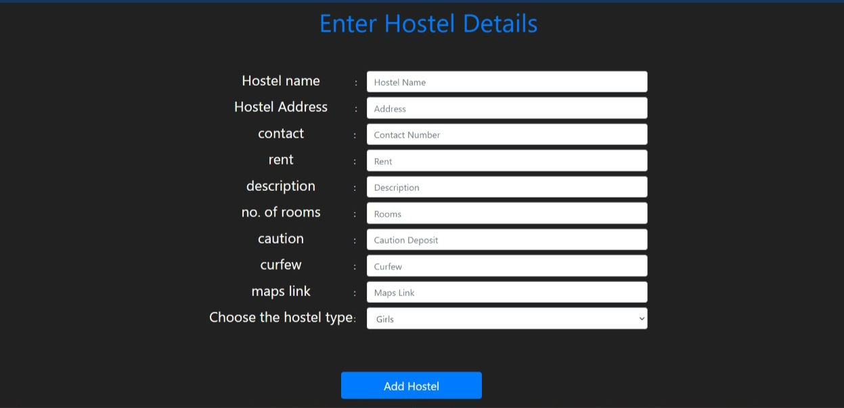


Input and Output
Input
Details of hostel ,rent , availability of rooms, Location , Features of
Rooms , e t c .. from the hostel owner.
Output
Hostel Searching facilities for the students.

Slide 6








HTML Python
CSS PyCharm
Bootstrap Sqlite3
Flask
Tools and Languages used

Slide 7
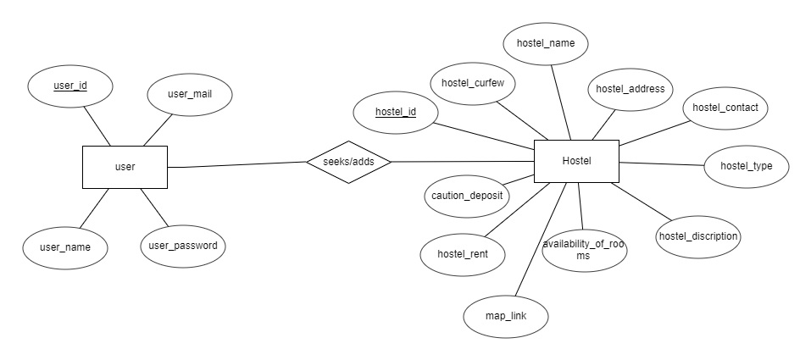
E R Diagram

Slide 8
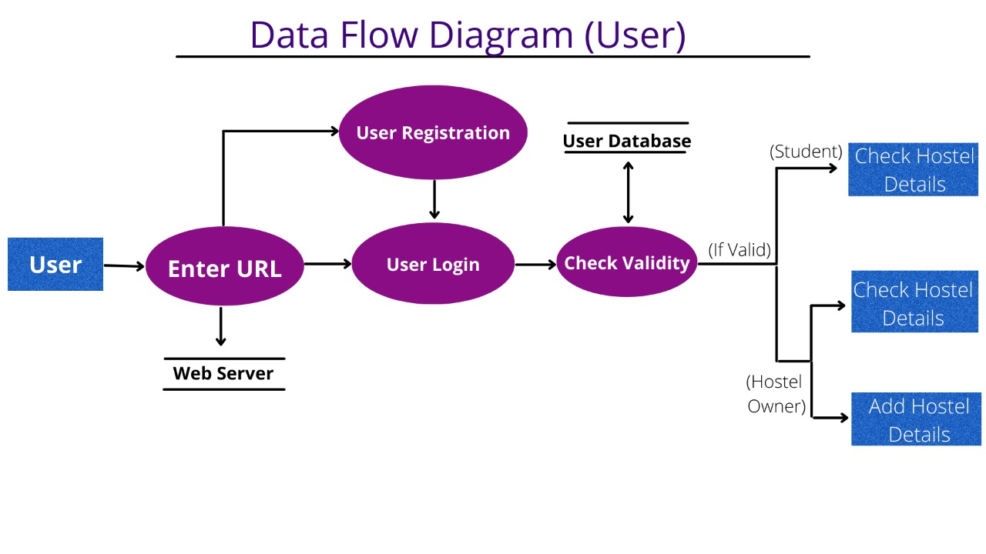
DFD for User

Slide 9
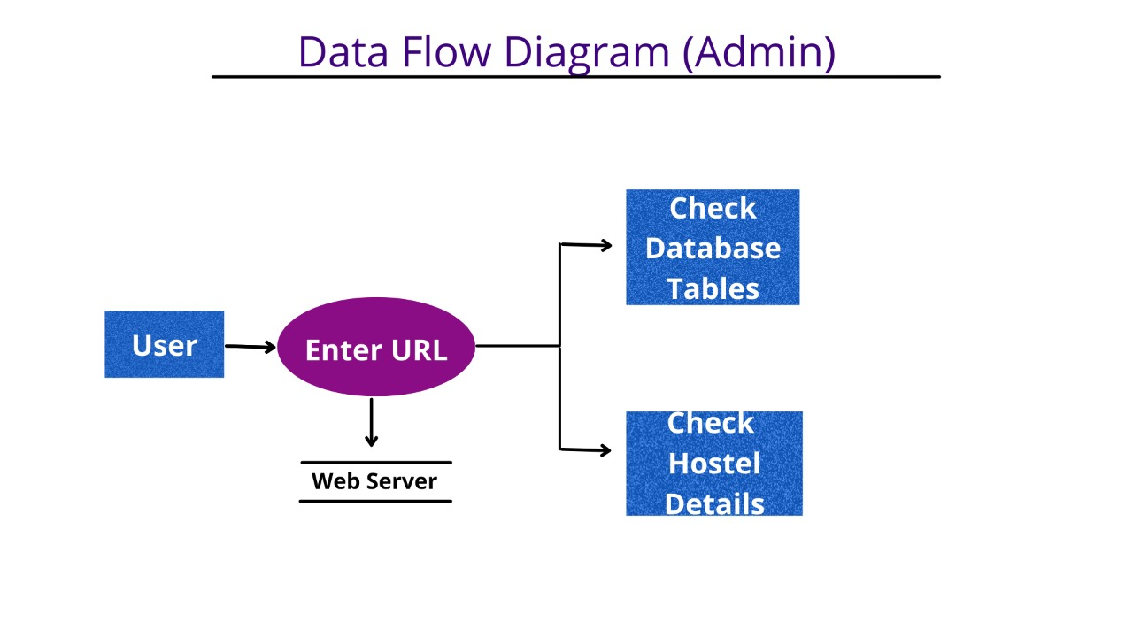
DFD for Admin

Slide 10
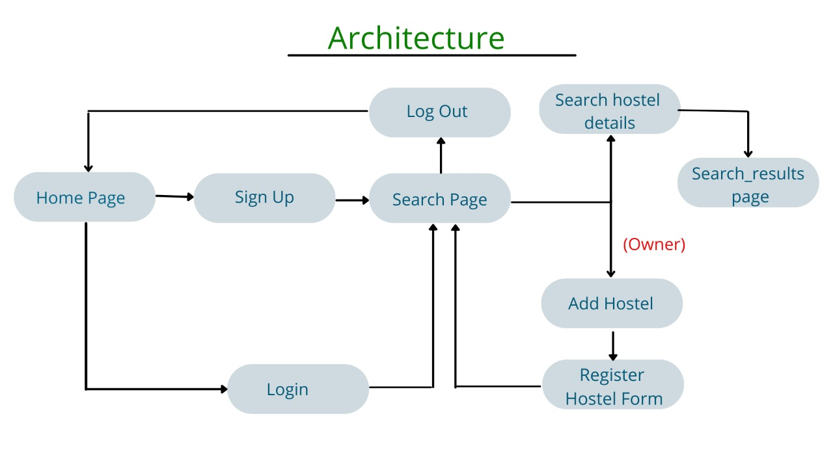
Structure of Website

Slide 11
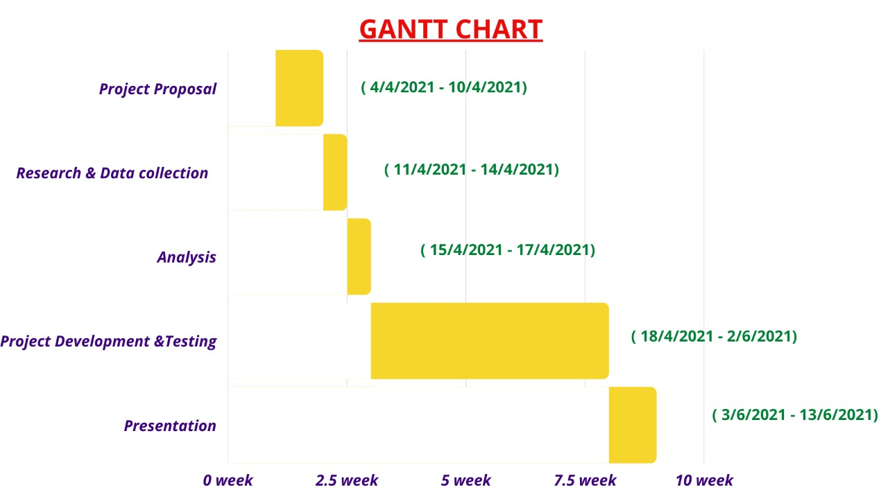
Roadmap

Slide 12
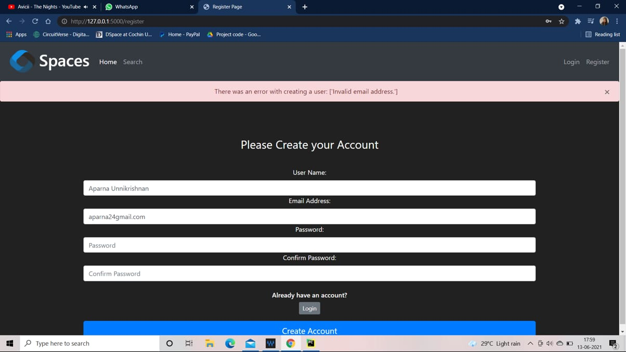
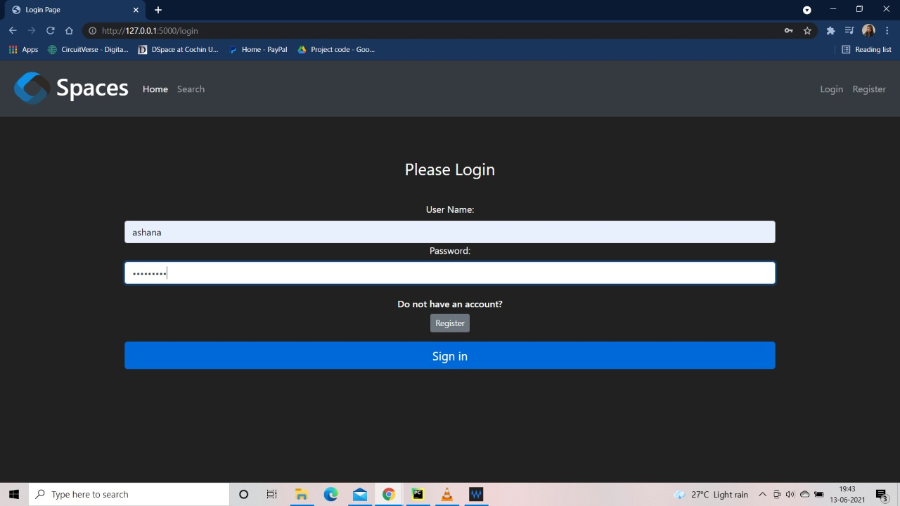
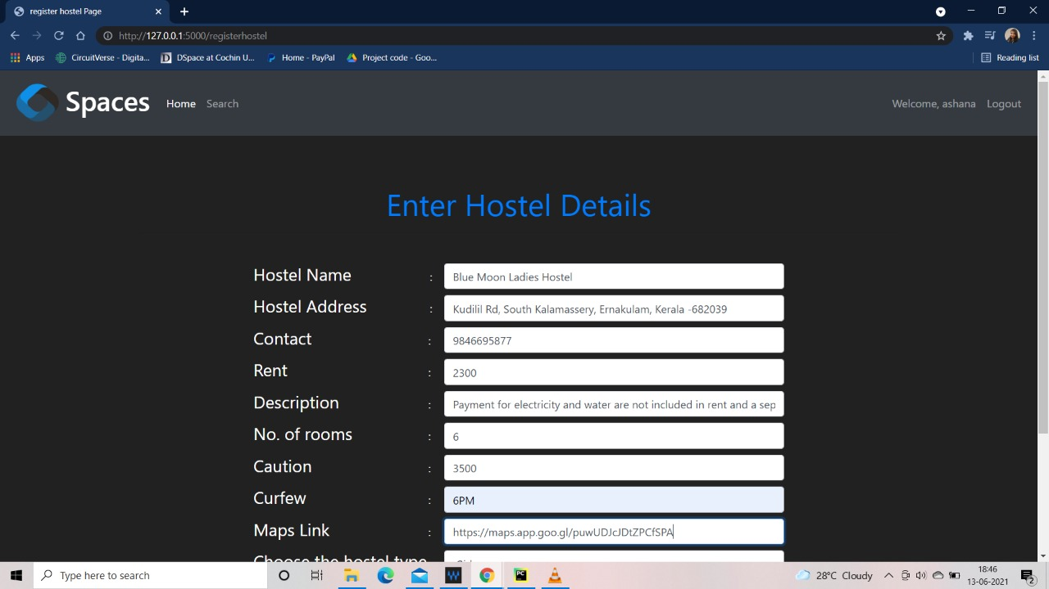
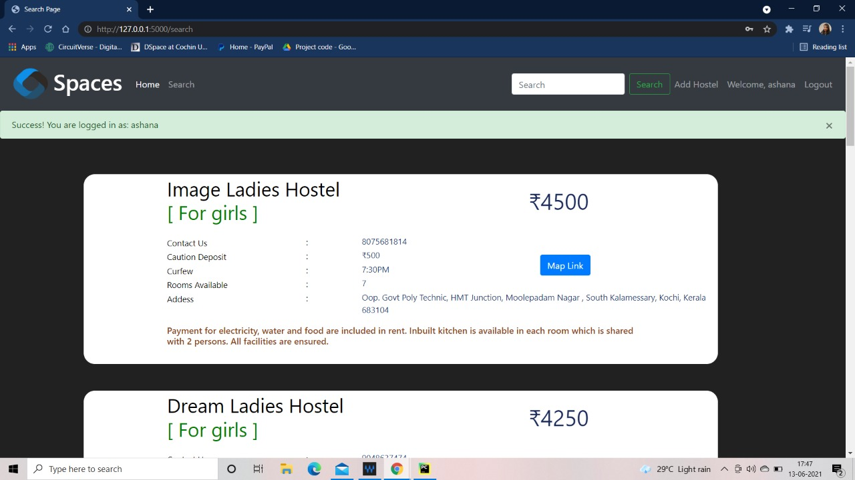
FORMS

Slide 13

Let’s see a Demo

Slide 14


Thank You
19it018anja@ug.cusat.ac.in
19it024apar@ug.cusat.ac.in
19it026asha@ug.cusat.ac.in

